Slide 1
In Silico Comparison of Photons versus Carbon Ions in Single Fraction Therapy of Lung Cancer
Kristjan Anderle

Slide 2
Outline
Introduction
Materials & Methods
Results
Conclusion & Outlook

Slide 3
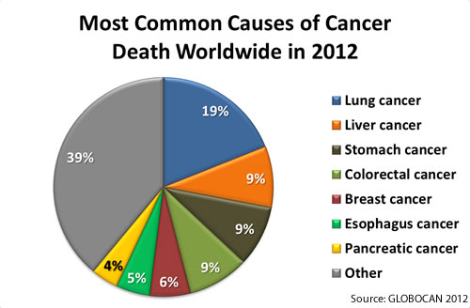
Introduction

Slide 4
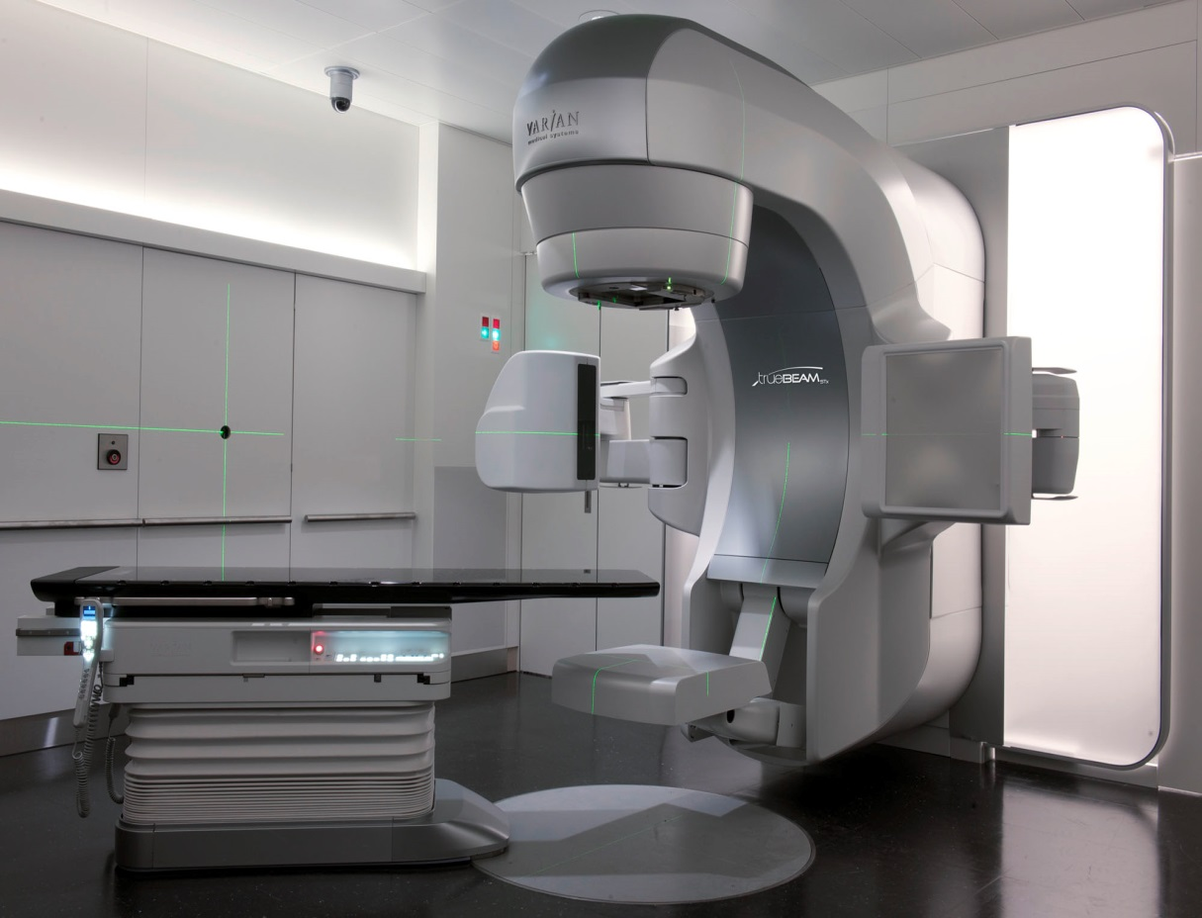
Stereotactic Body Radiation Treatment (SBRT)

Slide 5
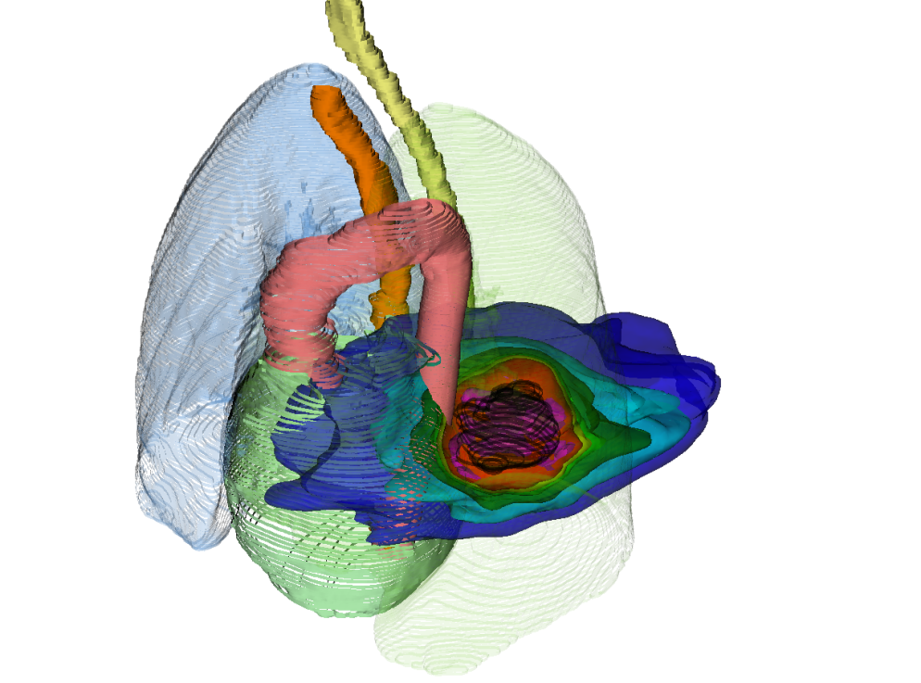
Introduction
photons

Slide 6
Introduction
photons
12C
photons
p+

Slide 7
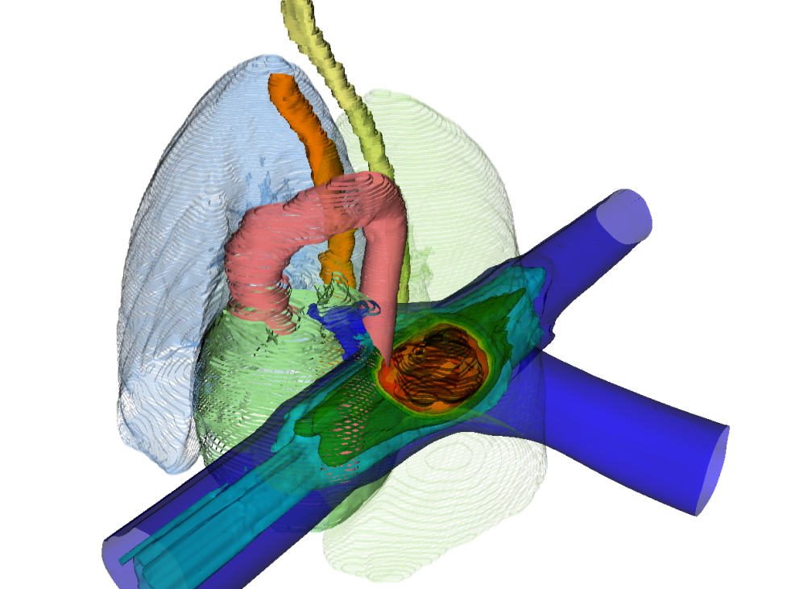
Introduction
photons
LEGENDA!
¹²C
12C
photons
p+

Slide 8
Introduction
PT Raster scanning
PT Bragg peak
PT range changes & interplay

Slide 9
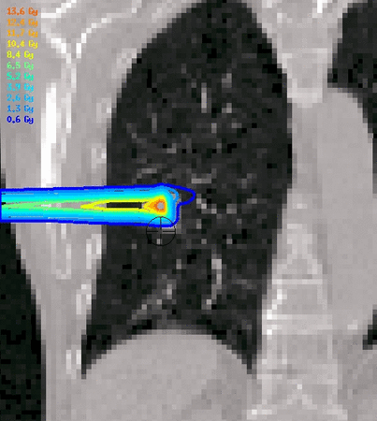
Introduction
PT Raster scanning
PT Bragg peak
PT range changes & interplay
Courtesy M. Söhn, LMU

Slide 10
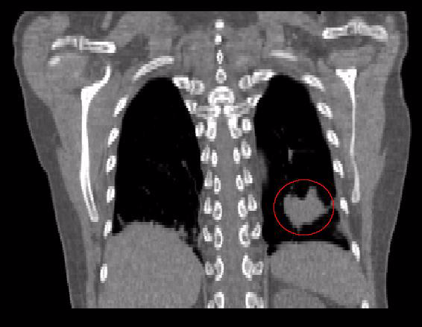
Deformable Image Registration

Slide 11
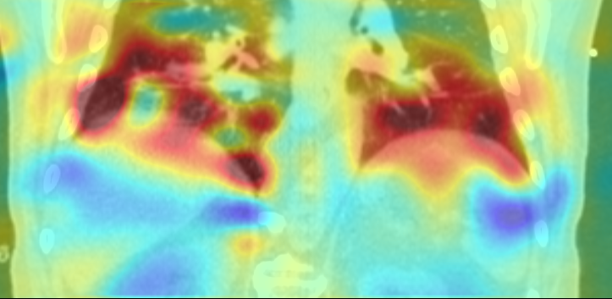
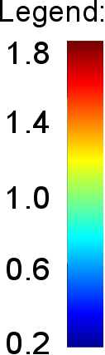
Deformable Image Registration Quality Assurance
Quality assurance with qualitative and quantitative test
Extensive verification, with over 1000 deformable image registrations
Jacobian map of vector field

Slide 12
Outline
Introduction
Materials & Methods
Results
Conclusion & Outlook

Slide 13
Patient Data
19 patients, 26 tumors
Average tumor volume: 2.9 cm³
Average tumor motion: 3.1 mm

Slide 14
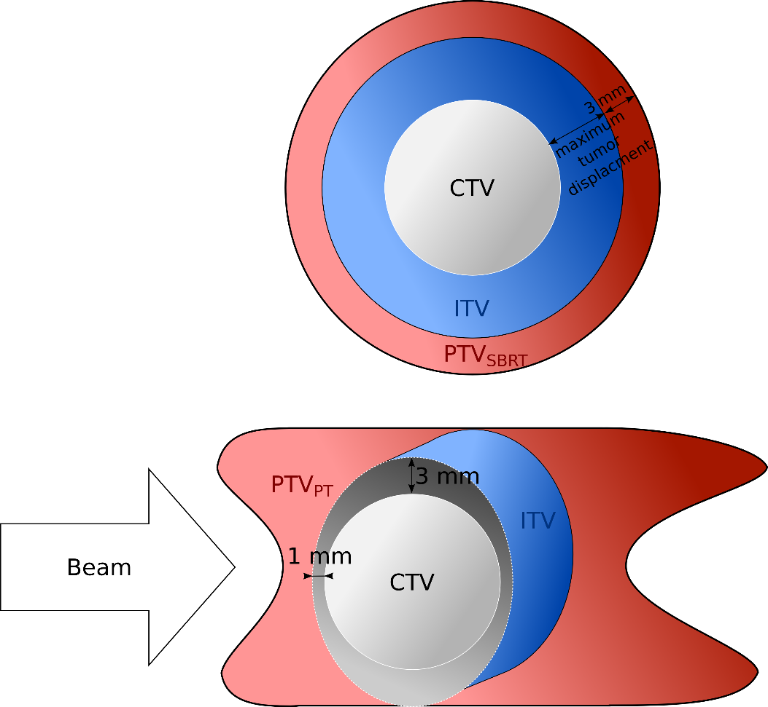
Patient Data – Normal Cases
19 patients, 26 tumors (each tumor 1 x 24 Gy)
Average tumor volume: 2.9 cm³
Average tumor motion: 3.1 mm
Single field uniform optimization

Slide 15
Patient Data – Normal Cases
SBRT single treatment plan
PT 10 dose calculations per patient:
Without motion, static (2x)
With motion, without compensation, 4D-interplay (4x)
With motion, with compensation, 4D-rescanning (4x)

Slide 16
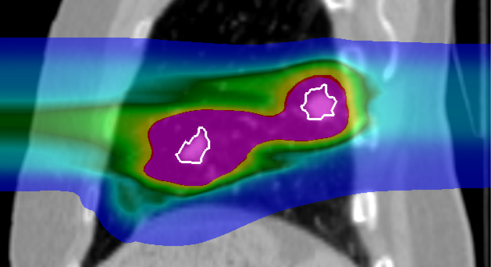
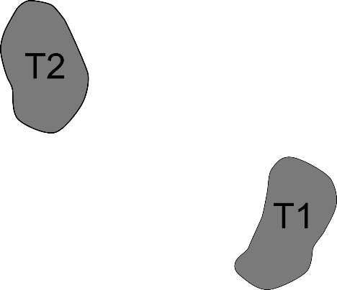
Intensity modulated particle therapy optimization for multiple targets

Slide 17
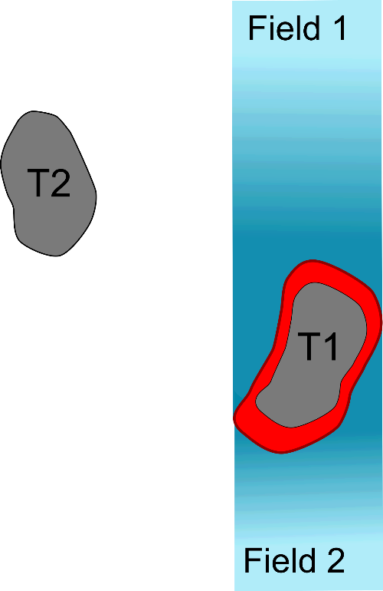
Intensity modulated particle therapy optimization for multiple targets

Slide 18
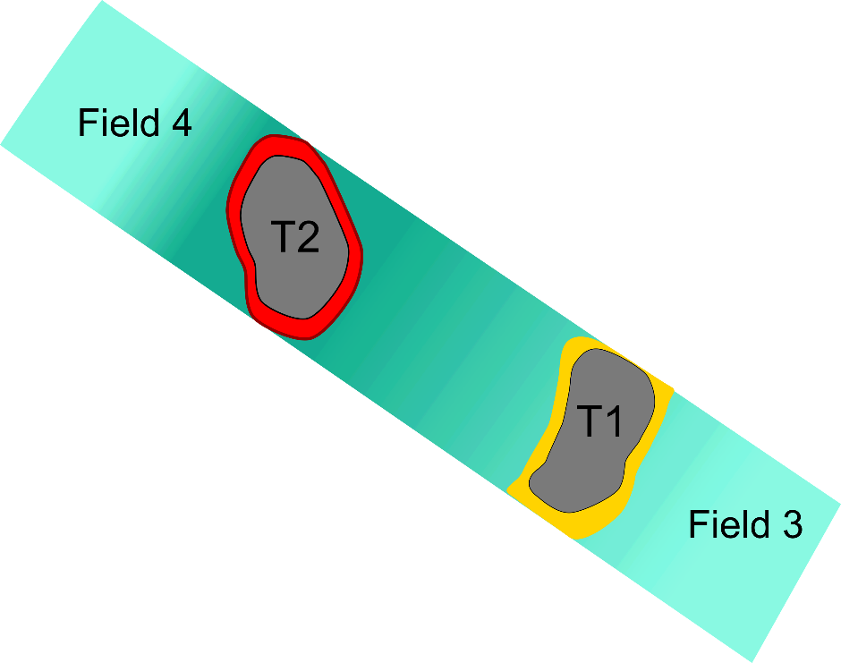
Intensity modulated particle therapy optimization for multiple targets

Slide 19
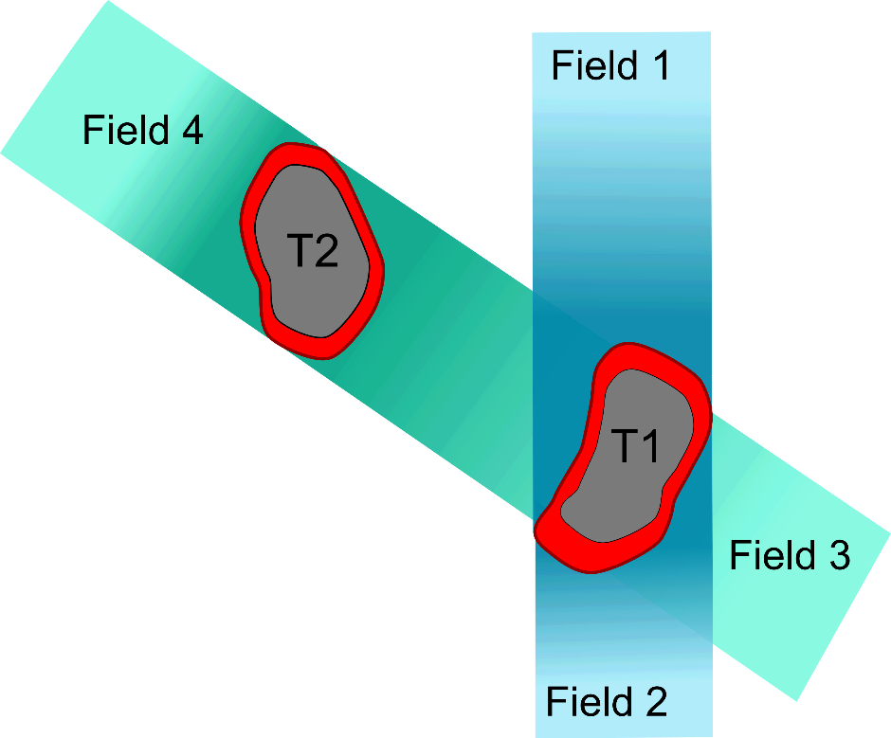
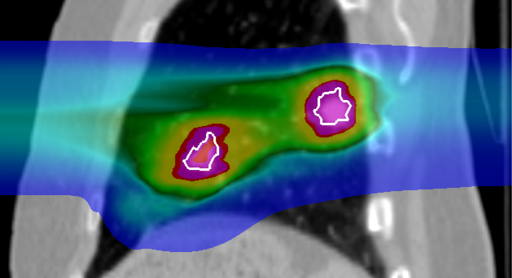
Intensity modulated particle therapy optimization for multiple targets

Slide 20
Patient Data - Complex Cases
8 patients, 24 tumors
Average tumor volume: 4.1 cm³
Average tumor motion: 5.9 mm
Two optimizations:
ITV
4D optimization

Slide 21
Patient Data - Complex Cases
SBRT single treatment plan
PT 8 dose calculation per patient:
2 optimizations, each 4 breathing patterns
Dose escalation for 3 patients to 1 x 24Gy

Slide 22
Outline
Introduction
Materials & Methods
Results
Conclusion & Outlook

Slide 23
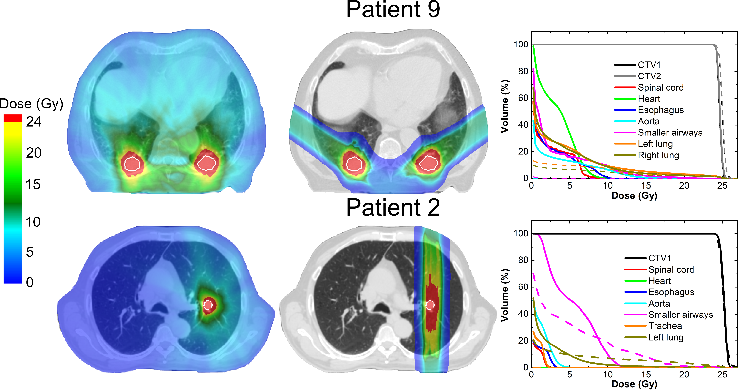

Normal Cases

Slide 24
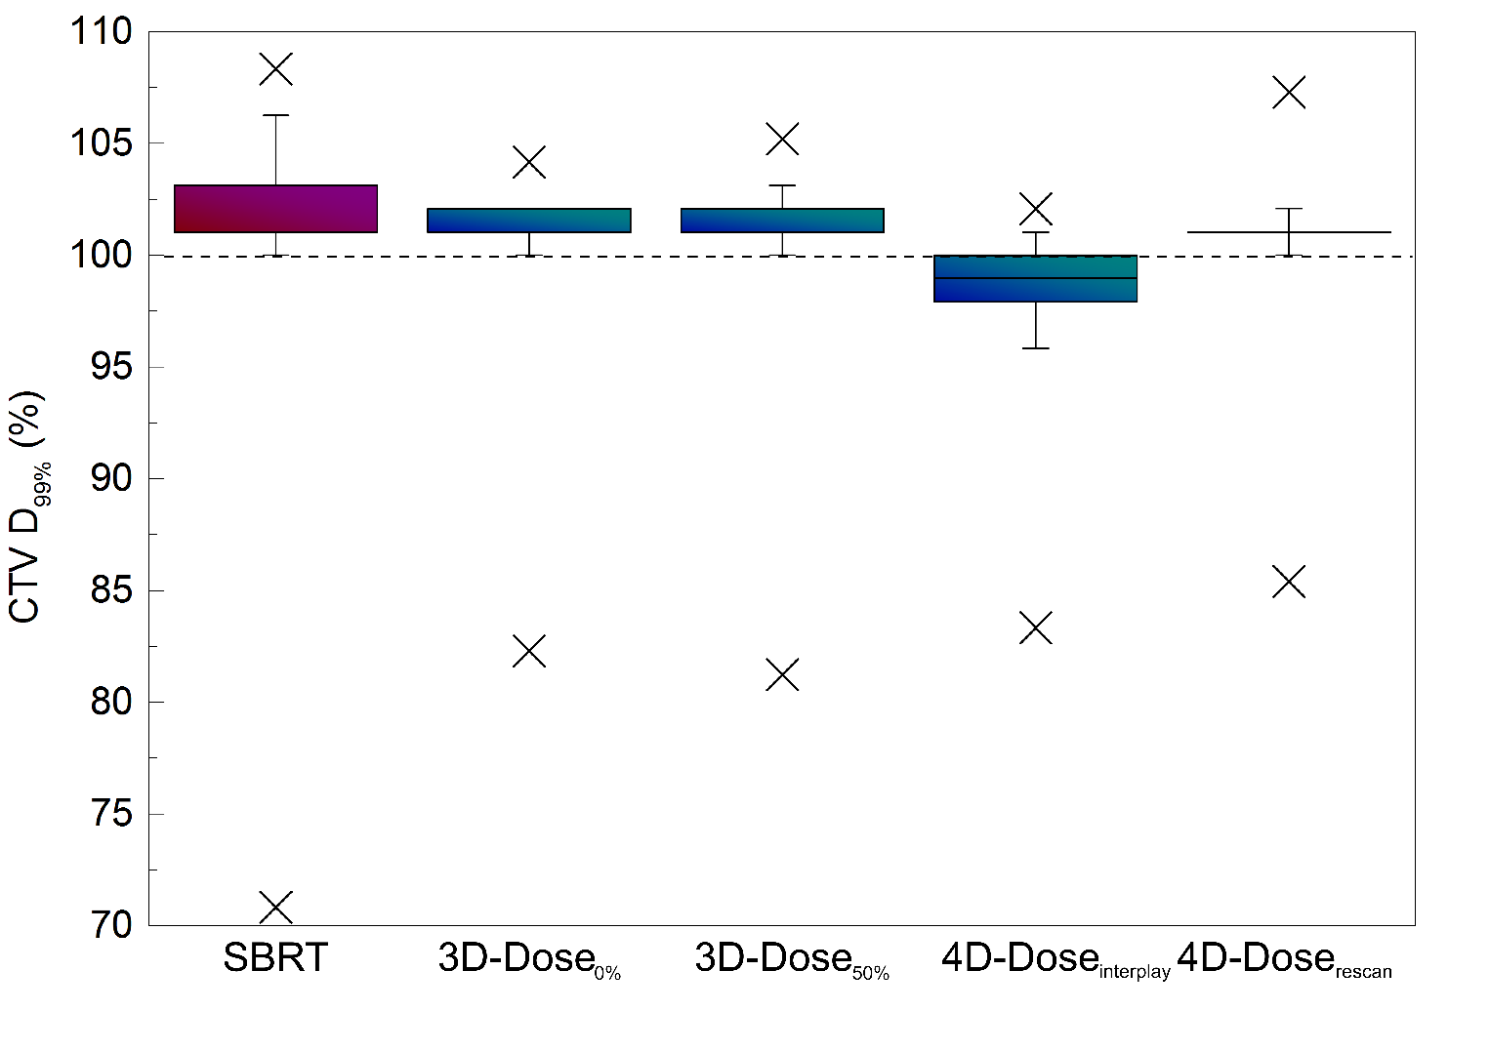
Normal cases – Tumor Irradiation

Slide 25
Normal Cases- OAR Irradiation

Slide 26
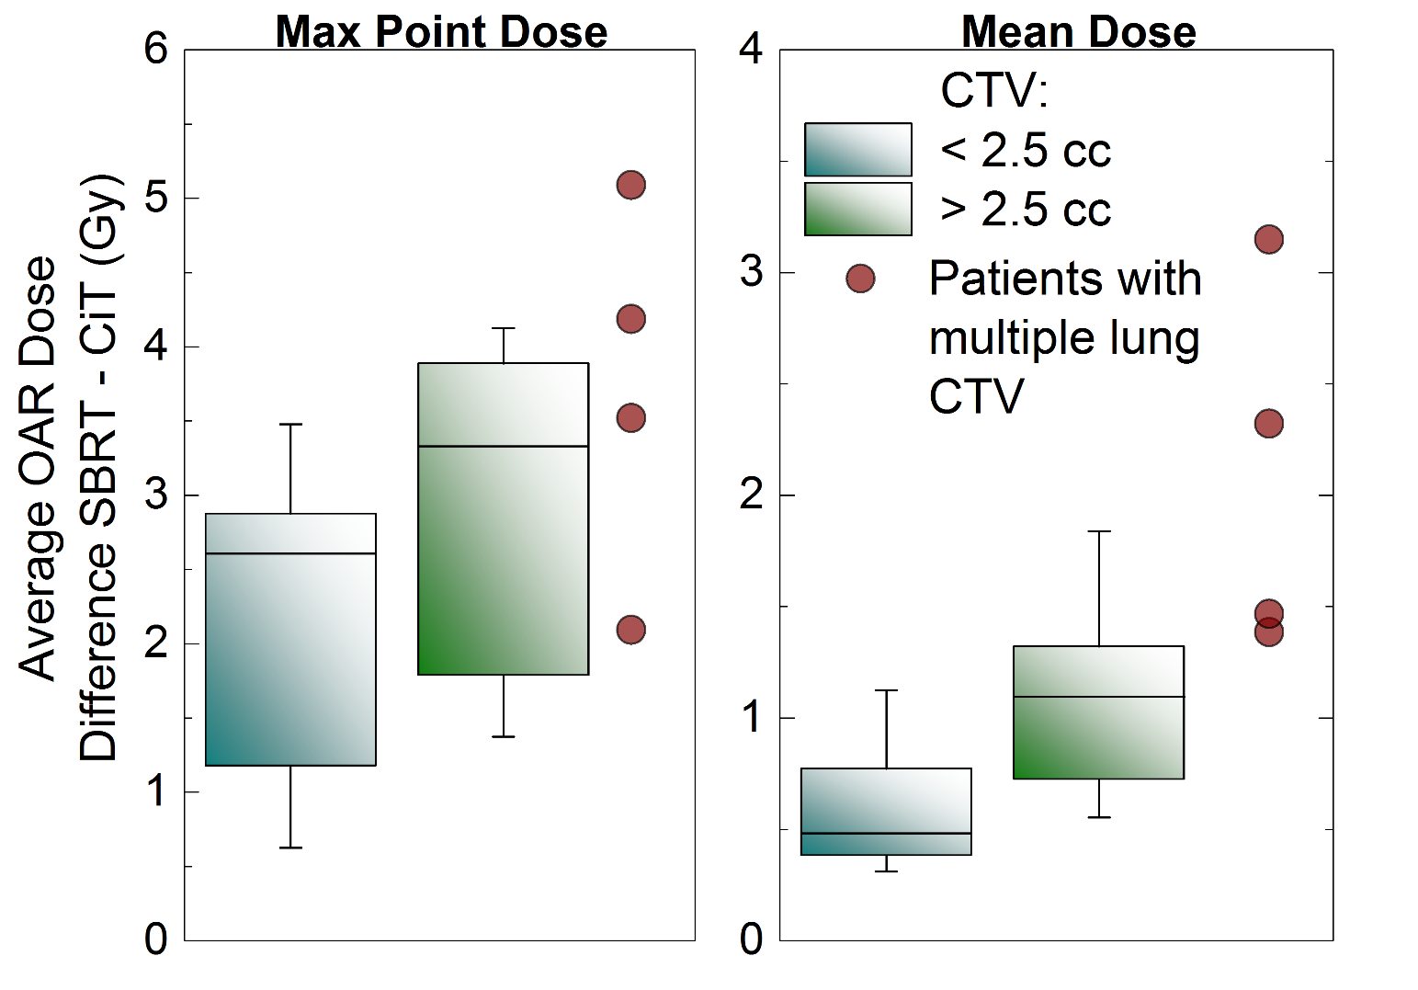
Normal cases – OAR Irradiation

Slide 27
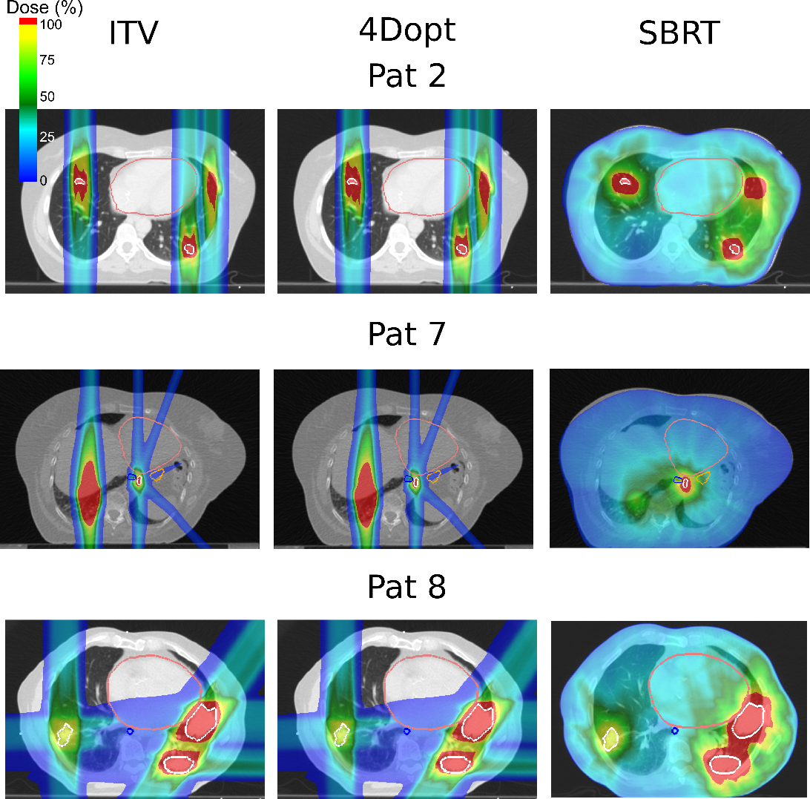
Complex Cases (show just PT and SBRT)

Slide 28
Complex Cases - Tumor Irradiation

Slide 29
Complex Cases - OAR Irradiation

Slide 30
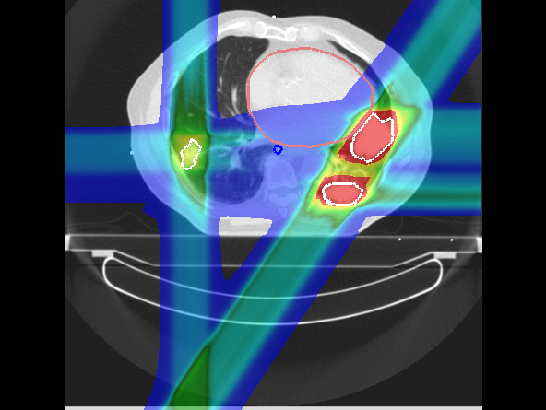
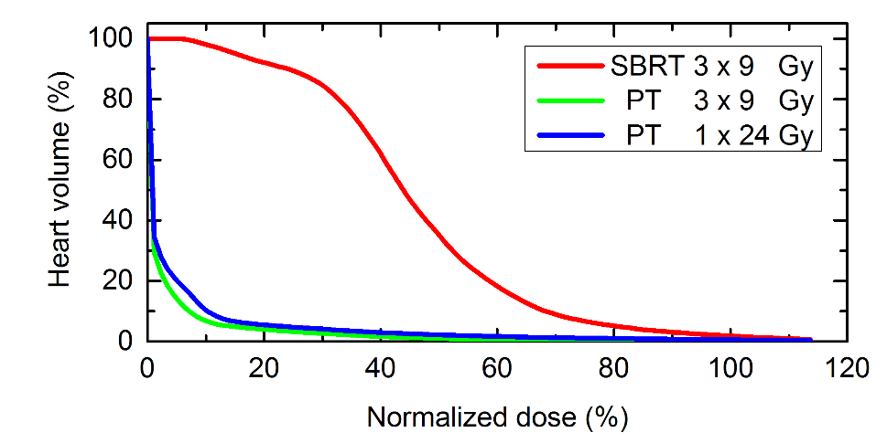
Complex Cases – dose escalation

Slide 31
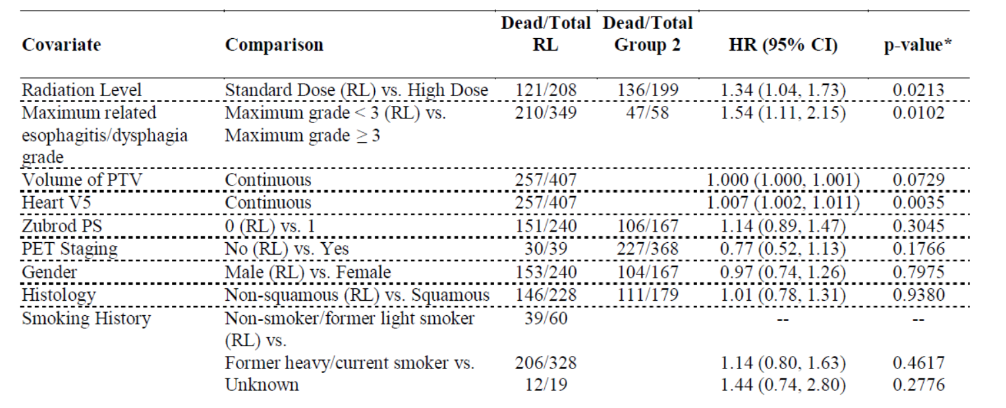
Clinical Trial RTOG 0617

Slide 32
Conclusions
PT delivers the same dose to tumors as SBRT
PT delivers significantely less dose to normal tissue
PT could deliver full ablative dose in single fraction, where SBRT could not
PT should be considered as a treamtent modality for lung cancer patients

Slide 33
Outlook
Phase III Randomized Trial Comparing Overall Survival After Photon Versus Proton Chemoradiotherapy for Inoperable Stage II-IIIB NSCLC (RTOG 1308), started in 2014, passive scattering proton therapy
First lung cancer patients treated with active scanning carbon-ions at NIRS, Chiba (Japan)
Löwe?

Slide 34

Acknowledgments
GSI
C. Graeff
M. Durante
A. Eichorn
M. Prall
S. Hild
FC
J. Stroom
C. Greco
N. Pimentel
S. Vierra
UK Erlangen
C. Bert
T. Brandt
J. Wölfelschneider

